Slide 1
Canadian Bioinformatics Workshops
www.bioinformatics.ca
bioinformaticsdotca.github.io

Slide 2
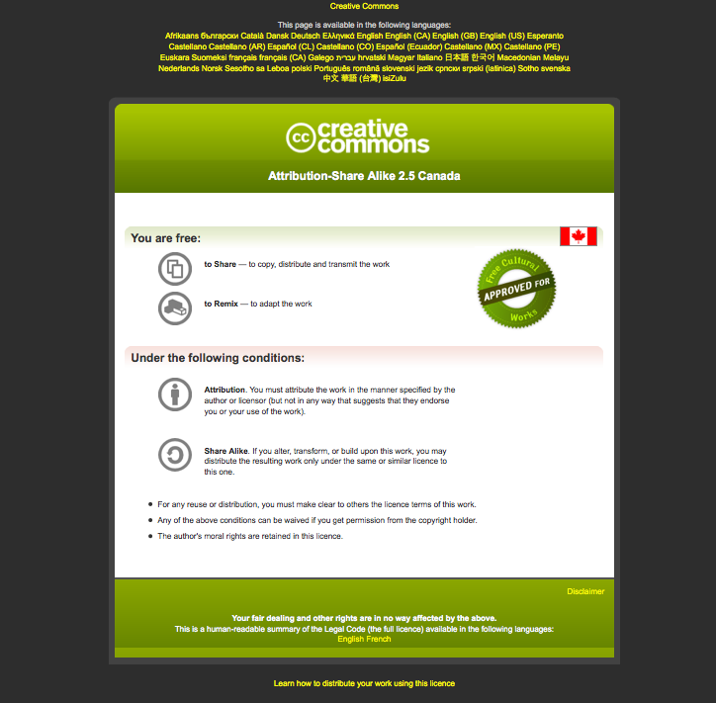

Slide 3
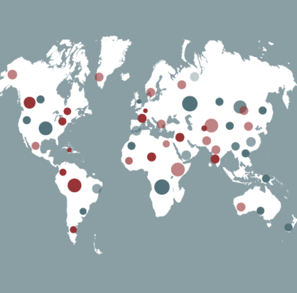

Tools and processes for infectious disease genomic epidemiology data curation and sharing
Emma Griffiths
Infectious Disease Genomic Epidemiology
April 18-21, 2023
Centre for Infectious Disease Genomics and One Health
Faculty of Health Sciences, Simon Fraser University
3

Slide 4
Learning Objectives
By the end of this lecture, you will:
Understand challenges of using genomics contextual data for public health analyses
Know how ontologies, data standards and tools can be used as solutions for streamlining data flow
Be able to describe real-world examples of how ontology-based specifications are used
Be aware of data sharing principles, considerations (practical, ethical, privacy)
Know about different public repositories (GISAID, INSDC) and their submission requirements
Be aware of data curation best practices

Slide 5





Contextual data is critical for interpreting the sequence data.
Sequence data
Contextual data (metadata) used for surveillance and outbreak investigations:
characterize lineages, sequence types, clusters
identify variants with clinical significance
correlate genomics trends with outcomes, risk factors
Monitoring and quality control
Comparing results between laboratories
Generating hypotheses about sources of infection/transmission etc
inform decision making for public health responses and monitor effects of interventions
Contextual data
Sample metadata
Lab results
Clinical/Epi data
Methods

Slide 6
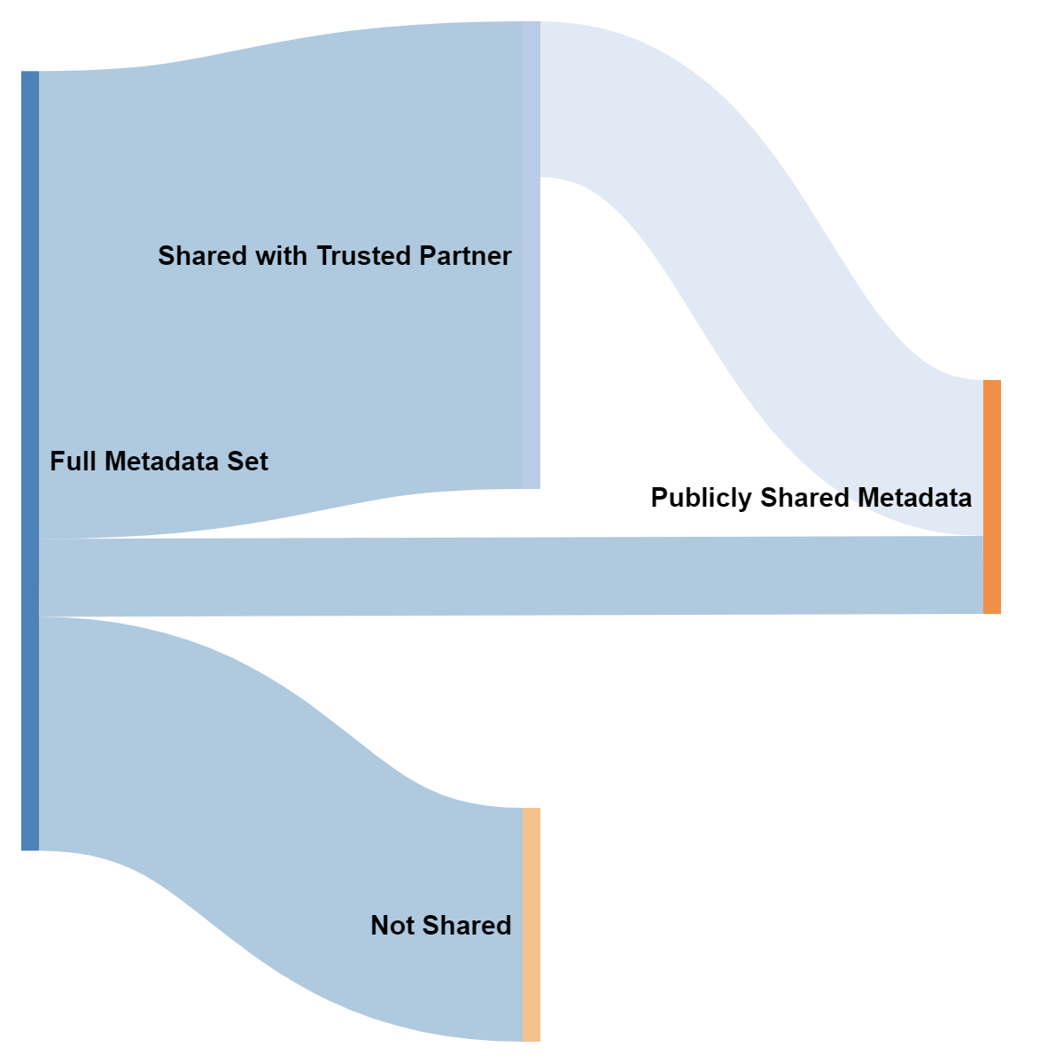
There are different kinds of data sharing.
Data comes from different sources
(labs, departments, databases)
Data needs to be shared within organizations, with trusted partners, with public repositories, with international agencies
Everyone uses different systems, processes

Slide 7
What does data heterogeneity look like?
Harmonizing fields of data is challenging.
SPECIMENSOURCE_1
Differences in labels,
Same meaning
Isolation
The labs mean “sample type”
host_tissue_sampled
Computer doesn’t recognize these as the same thing
Source
Same label,
Different meaning
The lab means “submitting lab”
Source
Computer doesn’t recognize these as different
A field by any other name does NOT smell as sweet…

Slide 8




Heterogeneity of values within a field also complicates using the data.
Free text =
Cough
vs
Dry cough
vs
Productive cough
vs
Cough with green phlegm
“in isolation”
RISK FACTORS:
Do you work with animals?
(exposures)
vs
Do you have diabetes?
(pre-existing conditions)
In-pateint
Np swad
UTM
NPS
Date:
2021-04-26
April 26, 2021
26-Apr-2021
Errors &
Short hand
Granularity
Semantic ambiguity
Formats
Different
Classifications/
Content

Slide 9
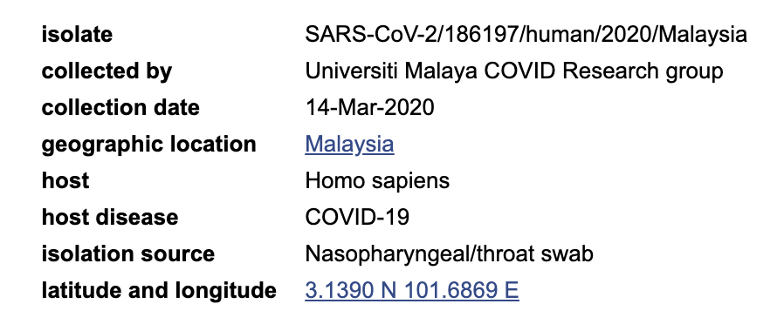
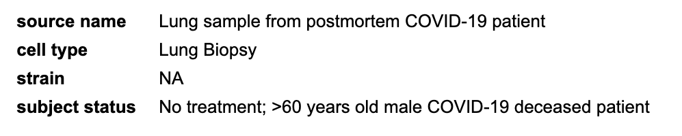
Variability in private databases propagates out to public repositories, complicating data integration/analyses.
Data structure impacts function.
It’s difficult to fit it all together. Data clean up takes time, resources.

Slide 10

How do we fix it?
1. Ontologies
universal language for humans and computers
Data standards
prescribed sets of fields, terms, formats
Tools
software and supporting materials to implement standards

Slide 11
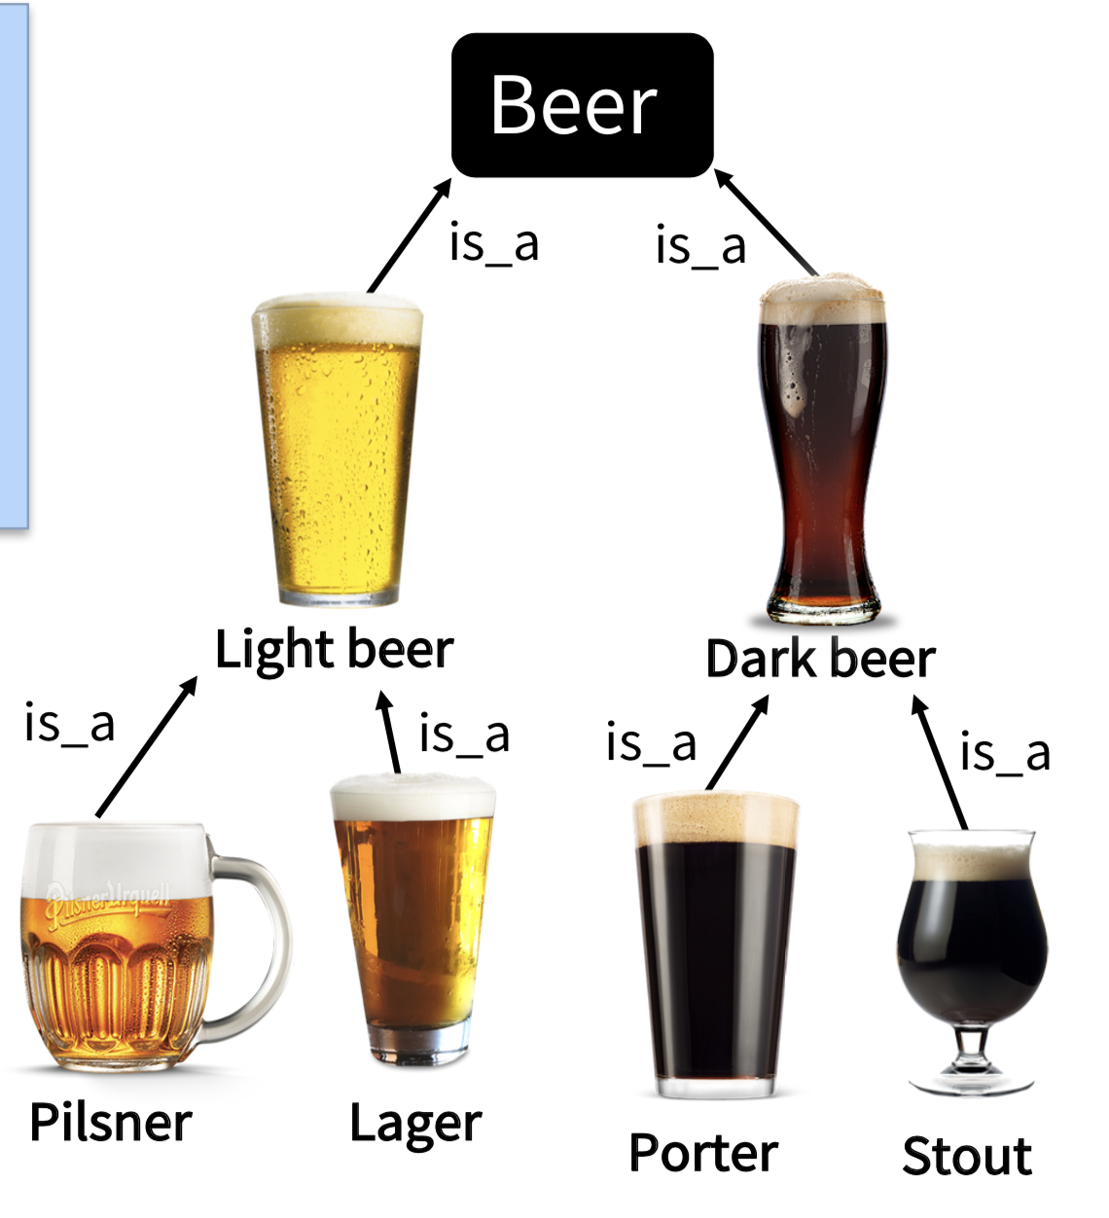


Ontology, A Way of Structuring Information
Ontologies aim to represent truth. Is this universal?
Controlled (standardized) vocabulary
Hierarchy (granularity)
Logic, machine actionable
Definitions and unique IDs (disambiguation)
Synonyms (facilitates mapping/interoperability)
Deprecation
has_ingredient
has_quality
produced_by
e.g. Lager beer [BeerO:1234]
A type of beer that uses a process of cool fermentation,
followed by maturation in cold storage.
e.g. Corona vs
Corona (sun) [ENVO:5555]
Lager beer [BeerO:1234]
e.g. suds, a cold one, pint, wobbly pop

Slide 12

Standards: ISO 23418:2022
Microbiology of the Food Chain — Whole genome sequencing for typing and genomic characterization of foodborne bacteria — General requirements and guidance
ISO standard provides tables and annexes to describe…
Contextual Data Fields
Sample Collection Lab Contact Information Geographic Location of Sample Collection Collection Date Sample Type Food Product Food Processing Environmental Material Environmental Location Collection Device Collection Method Microbiology Lab Contact Information Organism Strain Isolate Serotype Isolation Media Isolate Passage History
Information about the sample
Information about the isolate
Information about the sequence
Fields and terms sourced and adapted from:
Agency documentation
Public repository submission forms
Domain expert consultations
Existing standards and ontologies
ISO slim (package of fields and terms) available:
https://github.com/GenEpiO/iso2017

Slide 13
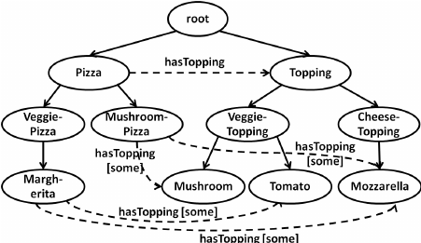
Ontologies: not just lists of terms, but how the terms relate to each
Pizza Data Specification
Pizza Ontology
Pizza types
Veggie pizza
Mushroom pizza
Margherita pizza
Toppings
Mushroom
Tomato
Mozarella
List of fields , possible values, format
Links particular toppings to particular pizza types

Slide 14


Real world examples of implementing ontology-based specifications in public health
SARS-CoV-2
(CanCOGeN)
MPXV

Slide 15

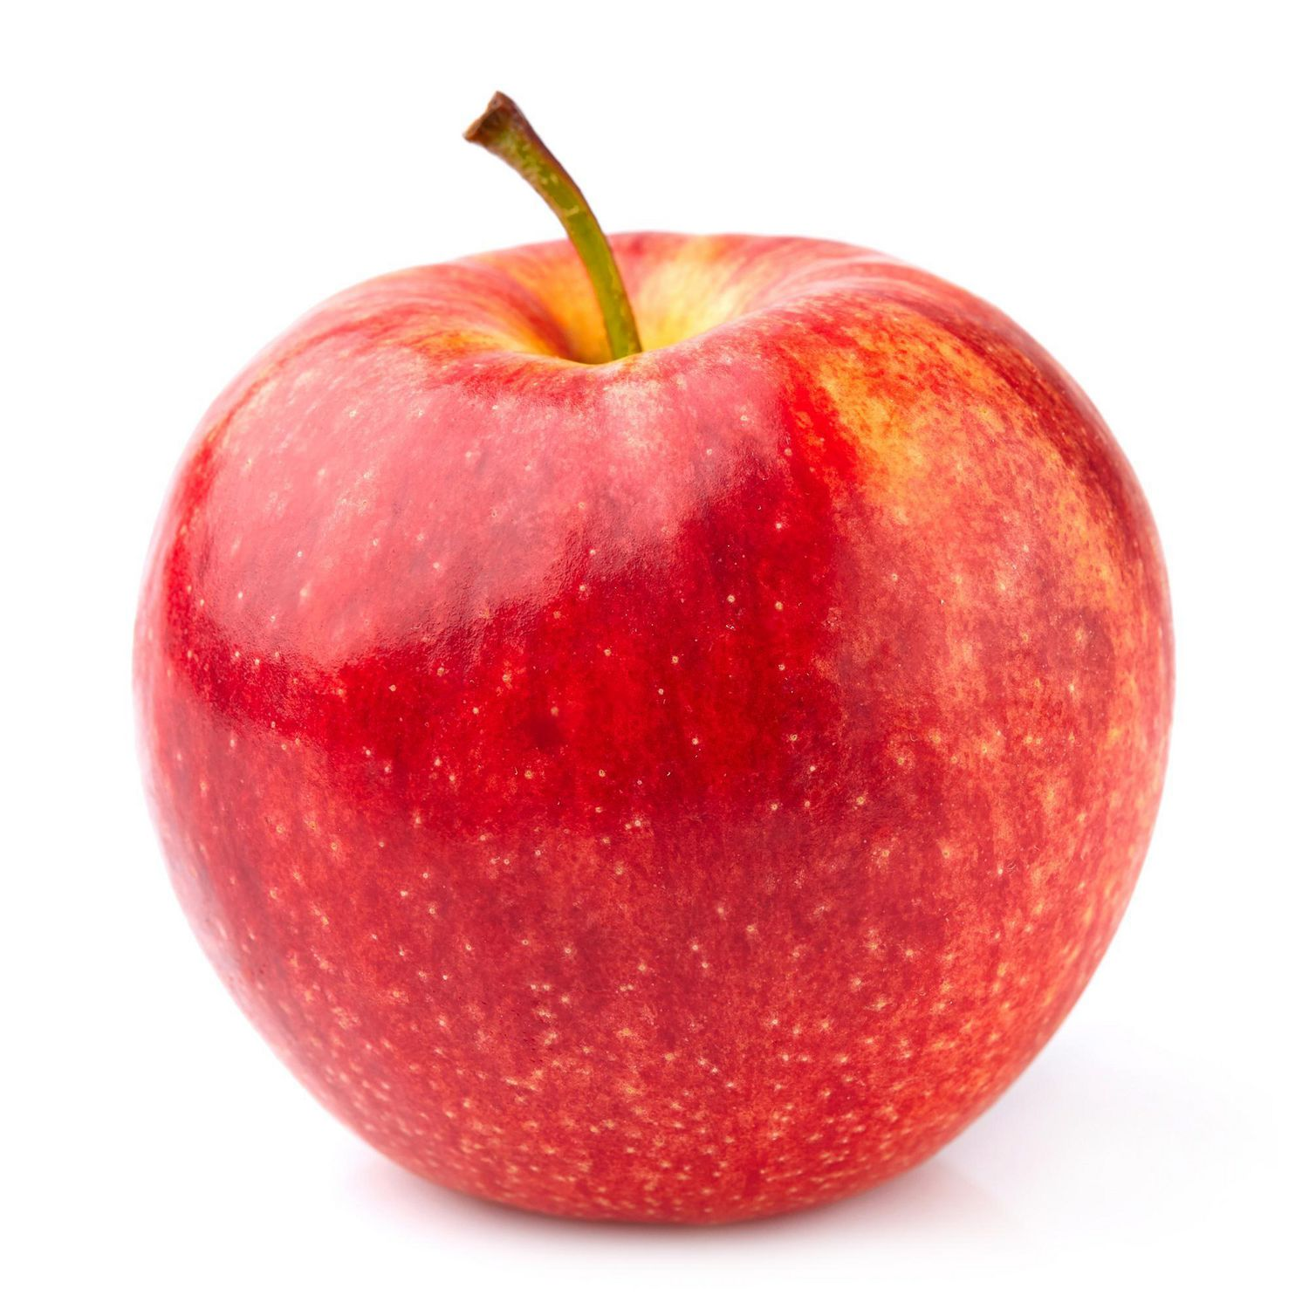





Data flow for Canadian SARS-CoV-2 genomic surveillance would be complicated by data heterogeneity.
Collect
Integrate
Disseminate
Data heterogeneity: slows down analysis
GISAID
National database
(NML PHAC)
NCBI
National surveillance priorities
(coordinated response)
Samples & contextual data collected at frontlines
Sequenced by different labs/services
Different provincial systems/priorities
Submitted to national DB (PHAC)
VirusSeq Data Portal

Slide 16
The CanCOGeN SARS-CoV-2 Contextual Data Standard
SARS-CoV-2 Domain Content
Repository accession numbers and identifiers
Sample collection and processing
Host information
Host exposure information
Host reinfection information
Host vaccination information
Sequencing methods
Bioinformatics and quality control metrics
Lineage and variant information
Pathogen diagnostic testing details
Provenance and attribution
Used ~24 ontologies, >1000 ontologized terms
Standardized null values
33 required fields
(who sequenced it, when/where/what was sampled, how sequenced, binfx)

Slide 17

Data standard development and tools to operationalize standards were critical to enabling harmonization and analyses.
Collect
Harmonize
Integrate
Disseminate
Standardize
Upload
GISAID
CanCOGeN SARS-CoV-2 Contextual Data Standard
Routine and analysis-specific curation
National database
+
Real-time response to changing data needs
NCBI
The DataHarmonizer
National surveillance priorities
VirusSeq Data Portal

Slide 18
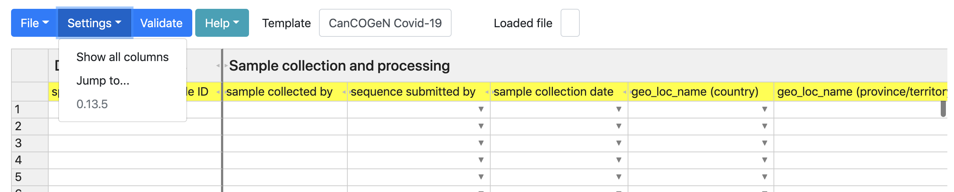
The DataHarmonizer enables standardized data entry and validation.
Tool for data entry and validation developed for CanCOGeN
Spreadsheet-style text editor application
Colour-coding, picklists, curation features, validation
Guidance, curation SOP, training
View all fields
View required fields
Move to desired field
Double click on field labels for guidance on how to fill them
Every submitting provincial public health lab has an instance
Validate
(check for errors or missing info)
Learn your way around the system
*Data upload format: xlsx, xls, tsv and csv
Save
Open existing file
Export to chosen format
Find the fields you need, learn what to put in them, fill the ones that apply to your sample, check the info is right.

Slide 19
Data transformation is required for different downstream destinations of data.
We will use this later in the lab!
Enter data once, export in different submission formats i.e. GISAID, VirusSeq Data Portal, NCBI BioSample as well as the national database (NML-LIMS).
Enter data once, export for different uses!
Get the latest version here: https://github.com/cidgoh/pathogen-genomics-package
MGen, 2022: https://www.microbiologyresearch.org/content/journal/mgen/10.1099/mgen.0.000908

Slide 20
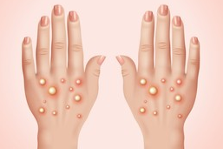
Benefits of a common pathogen surveillance framework:
Repurposing the SC2 specification for the Monkeypox Epidemic
On July 23, 2022, the World Health Organization (WHO) declares MPXV a Public Health Emergency of International Concern
As MPXV was growing concern → need for genomic surveillance
Developed a template in the DH
Reused most fields, customize some pick lists (e.g. anatomical sites – Nasopharyngeal swabs (SC2) vs Groin (MPXV) ; anatomical material - Lesion (Pustule), Lesion (Vesicle))
Avoid proliferation of incompatible specifications!

Slide 21
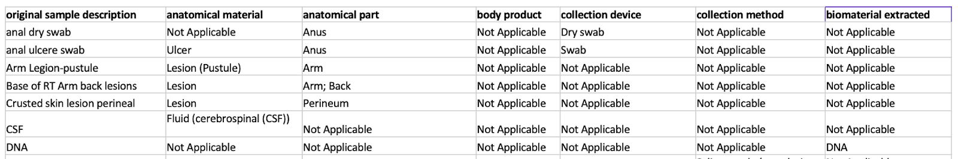
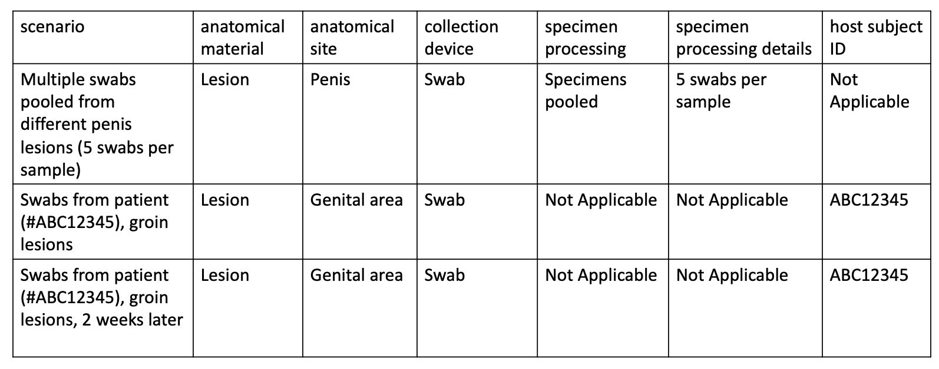
Harmonization of:
variable clinical sample descriptions
2) specimen processing (pooling samples) and sequential sampling from the same individuals (subject host ID)

Slide 22
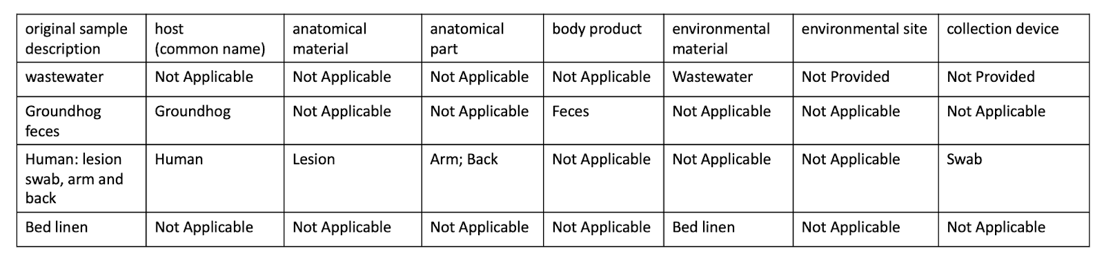
3) One Health MPXV samples (wastewater, fomites, other hosts)
Harmonized contextual data in NCBI: BioProject PRJNA846794

Slide 23
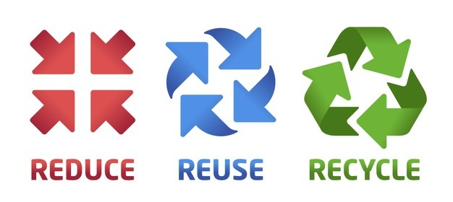
Benefits of using interoperable data standards
time
workload
uncertainty
fields/terms
increased interoperability/ standardization
expectations
agreements
skills
tools/processes
training, protocols

Slide 24
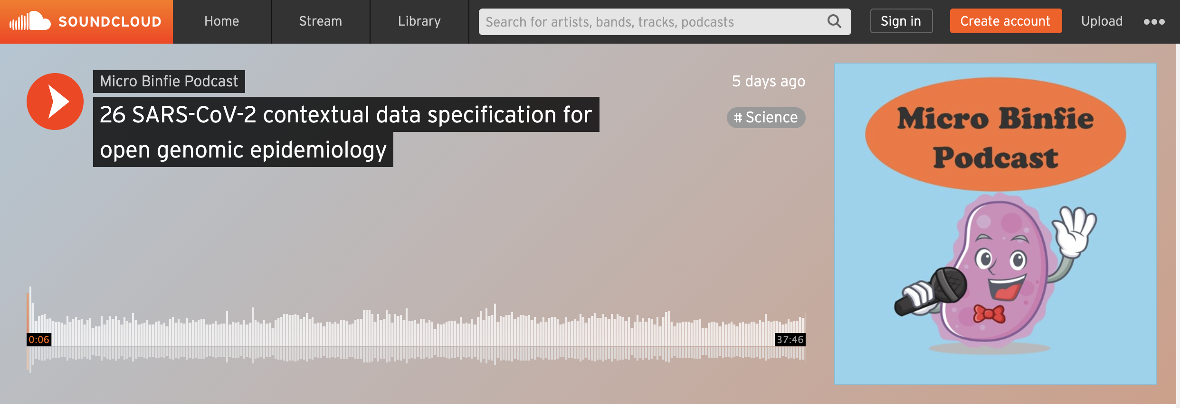
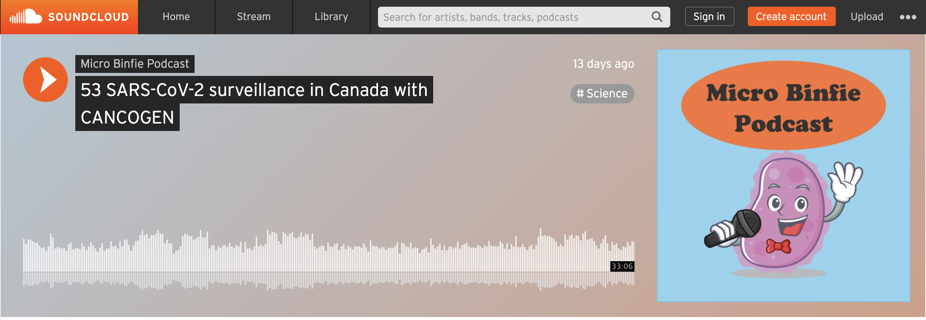
How can I learn more?
Read the manuscript:
GigaScience, Volume 11, 2022, giac003,
https://doi.org/10.1093/gigascience/giac003
Podcast: https://soundcloud.com/microbinfie/26-sars-cov-2-metadata#t=0:00
Podcast:
https://soundcloud.com/microbinfie/sars-cov-2-surveillance-in-canada-with-cancogen

Slide 25
Why should I share data?
1. Situational awareness: lack of data sharing creates blind spots
2. Diagnostics/therapeutics (make sure your viruses covered)
3. Having a voice in global decision making (data creates leverage)
4. Data sharing in a human rights framework (GA4GH)
Article 27 of the 1948 Universal Declaration of Human Rights
right of all citizens in all countries to the benefits of the advancements of science (duty to share)
right of attribution of scientists
reinforces the right of scientific freedom
5. Being a good data citizen
https://www.ga4gh.org/genomic-data-toolkit/regulatory-ethics-toolkit/framework-for-responsible-sharing-of-genomic-and-health-related-data/

Slide 26
Data stewardship: oversight and practices to ensure data is accessible, usable, safe, trusted.
Privacy protection (sharing):
Public trust essential, loss of trust has consequences (protection, transparency)
De-identified data (no names/addresses)
Be careful of 1) geographical granularity, 2) small case numbers in defined geo_loc/time, 3) combinations of fields
Track identifiers (chain of custody), but personal health IDs/sample IDs may be considered PHII
Consult privacy officer (jurisdictional policies, national legislation)
Security & Quality:
Provenance, methods (rich details) → attribution, auditability, reproducibility (track methods), accountability
Contextual data may require storage with higher security than seq data
Errors corrected, update as required
26

Slide 27
Types of contextual data critical for surveillance/ genomic epidemiology (what you can most likely share)
Geo_loc (at least country, preferably state/province) – sample collection
Sample collection date (to the day)
Attribution: Who collected sample, who sequenced it
Methods: instrument (platform & model), consensus sequence software, coverage
Sampling strategy (random sampling, targeted sampling, outbreak, research)
Demographics: age/sex (gender)
Sample type
Host
Quality indicators (e.g. Ct values)
Vaccination
Exposures
Travel history
Hospitalization
Outcomes

Slide 28
Submitting to public repositories is crucial for global surveillance
Main public repositories GISAID and INSDC (NCBI, ENA, DDBJ)
Different but overlapping requirements
Submitting to different repos is encouraged, transformation will be necessary
What you collected, how you structured it (in your spreadsheet or LIMS) may be different than the submission requirements
What you share depends on your data sharing policies
No matter which repository you choose, you will need to do the following:
Stage 1: Set up an account
Stage 2: Prepare your contextual and sequence data (fastq/fasta) files
Stage 3: Submit

Slide 29
Data Sharing: Public Repositories
Open Access
Controlled Access
International Nucleotide Sequence
Database Collaboration (INSDC)
NCBI (USA)
EBI-ENA (UK)
DDBJ (Japan)
Nodes that mirror data
No restrictions
Everything (all organisms, lots of data types, research & public health)
Specific databases (assemblies, raw data, Pathogens, AMR, metagenomics, RNA-Seq, etc)
Global Initiative on Sharing Avian Influenza Data (GISAID)
Influenza
SARS-CoV-2
MPXV
RSV
Data use restrictions (Terms of Service)
Geared towards surveillance and public health
Assembly/consensus sequence focused
Dashboards

Slide 30
GISAID
Register and sign agreement to access templates (attribution, collaboration, data use restrictions)
Template is what you will submit, includes instructions (different templates for different organisms)
Check for updates!

Slide 31
GISAID Contextual data requirements
GISAID Fields (as of 2020-06-19) | GISAID Definition
Submitter | enter your GISAID-Username
FASTA filename | the filename that contains the sequence without path (e.g. all_sequences.fasta not c:\users\meier\docs\all_sequences.fasta)
Virus name | e.g. hCoV-19/Canada/BC-prov123/2020 (Must be FASTA-Header from the FASTA file all_sequences.fasta)
Type | default must remain "betacoronavirus"
Passage details/history | e.g. Original, Vero
Collection date | Date in the format YYYY or YYYY-MM or YYYY-MM-DD
Location | e.g. Europe / Germany / Bavaria / Munich
Additional location information | e.g. Cruise Ship, Convention, Live animal market
Host | e.g. Human, Environment, Canine, Manis javanica, Rhinolophus affinis, etc
Additional host information | e.g. Patient infected while traveling in ….
Sampling Strategy | e.g. Sentinel surveillance (ILI), Sentinel surveillance (ARI), Sentinel surveillance (SARI), Non-sentinel-surveillance (hospital), Non-sentinel-surveillance (GP network), Longitudinal sampling on same patient(s), S gene dropout
Gender | Male, Female, or unknown
Patient age | e.g. 65 or 7 months, or unknown
Patient status | e.g. Hospitalized, Released, Live, Deceased, or unknown
Specimen source | e.g. Sputum, Alveolar lavage fluid, Oro-pharyngeal swab, Blood, Tracheal swab, Urine, Stool, Cloakal swab, Organ, Feces, Other
Outbreak | Date, Location e.g. type of gathering, Family cluster, etc.
Last vaccinated | provide details if applicable
Treatment | Include drug name, dosage
Sequencing technology | e.g. Illumina Miseq, Sanger, Nanopore MinION, Ion Torrent, etc.
Assembly method | e.g. CLC Genomics Workbench 12, Geneious 10.2.4, SPAdes/MEGAHIT v1.2.9, UGENE v. 33, etc.
Coverage | e.g. 70x, 1,000x, 10,000x (average)
Originating lab | Where the clinical specimen or virus isolate was first obtained
Address
Sample ID given by the sample provider
Submitting lab | Where sequence data have been generated and submitted to GISAID
Address
Sample ID given by the submitting laboratory
Authors | a comma separated list of Authors with complete First followed by Last Name

Slide 32
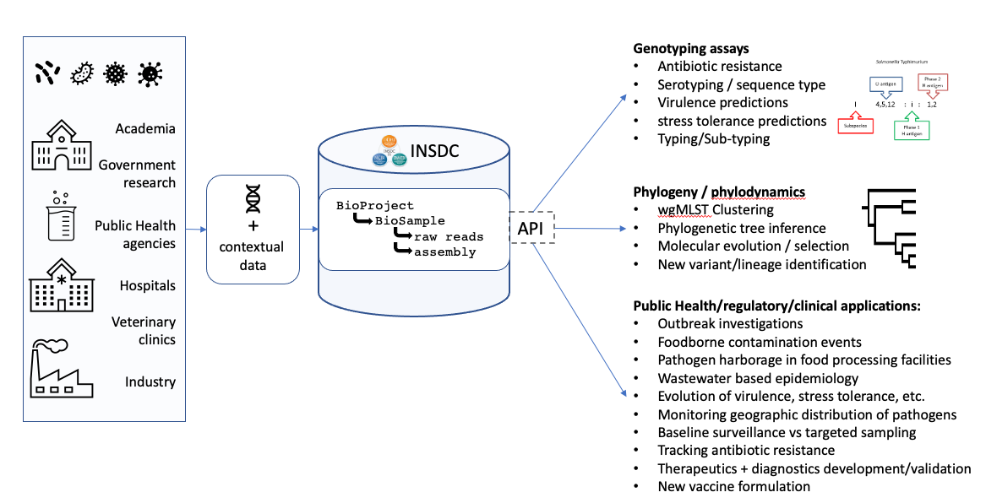
International Nucleotide Sequence Database Collaboration
Submission: programmatically or via web client
BioSample metadata
+
Experiment metadata
*both accept user-
defined fields

Slide 33
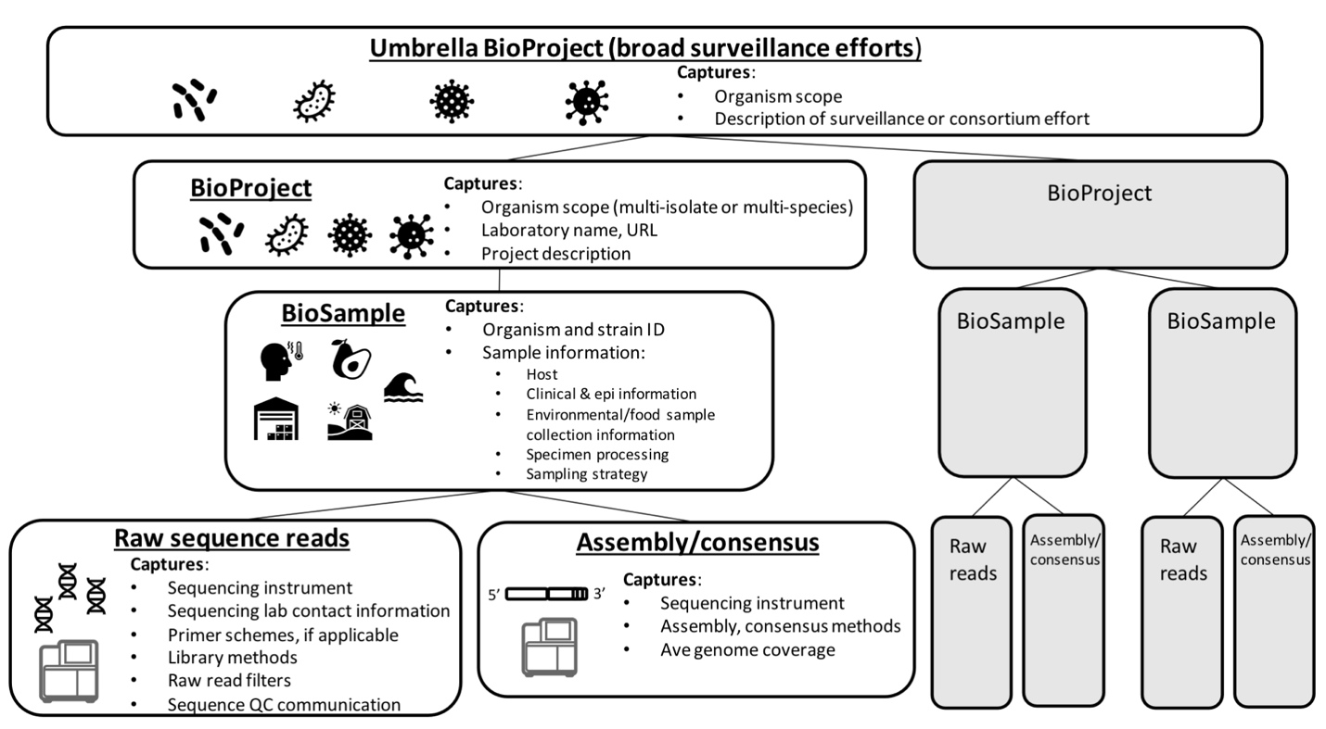
INSDC Data Model

Slide 34
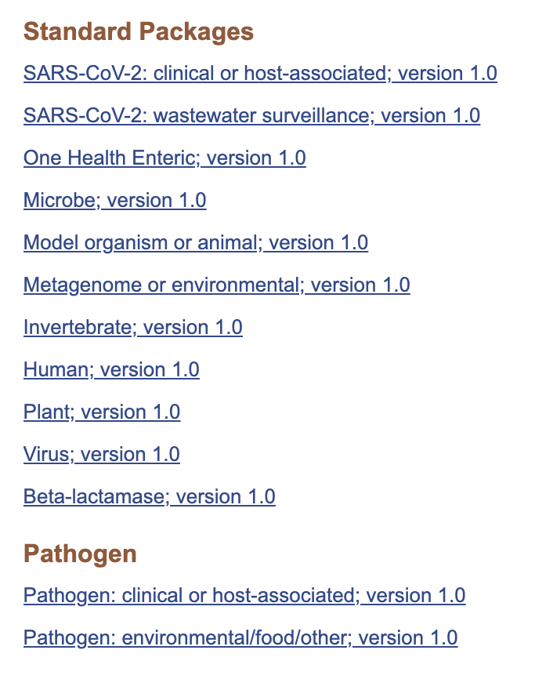
BioSample Metadata Packages
sets of specifications (fields) → interoperability, standardization
authoritative source (Genomics Standards Consortium)
describing samples from different contexts (e.g. clinical, environment, food) or for different kinds of sequences (e.g. single genomes, metagenomes, marker genes)
user selects most appropriate package → Pathogen packages (also different SARS-CoV-2 package)

Slide 35
GISAID | ENA Virus Package
Submitter | No equivalent (submit from your account)
FASTA filename | file_name (See Experiment metadata)
Virus name | isolate
Type | tax_id (See Experiment metadata)
Passage details/history | No equivalent
Collection date | collection date
Location | geographic location (country and/or sea)
Host | host common name/host scientific name
Gender | host sex
Patient age | host age
Patient status | host health state
Sequencing technology | instrument_model (See Experiment metadata)
Originating lab | collecting institution
Address | collecting institution
Submitting lab | No equivalent (submit from your account)
Address | No equivalent (submit from your account)
No equivalent | host subject id
Mapping Between Formats
GISAID Virus name:
hCoV-19/Country/ISO regional code-Identifier/year
hCoV-19/Country/un-Identifier/year
e.g. hCoV-19/CANADA/BC-ABCD1234/2021
NCBI Isolate:
SARS-CoV-2/host/country(short)/sampleID/date
e.g. SARS-CoV-2/human/CAN/ABCD1234/2021
*remember, even if something is “required”, you can always provide a null value if you need to
e.g. Missing, Not Applicable, Not Collected

Slide 36
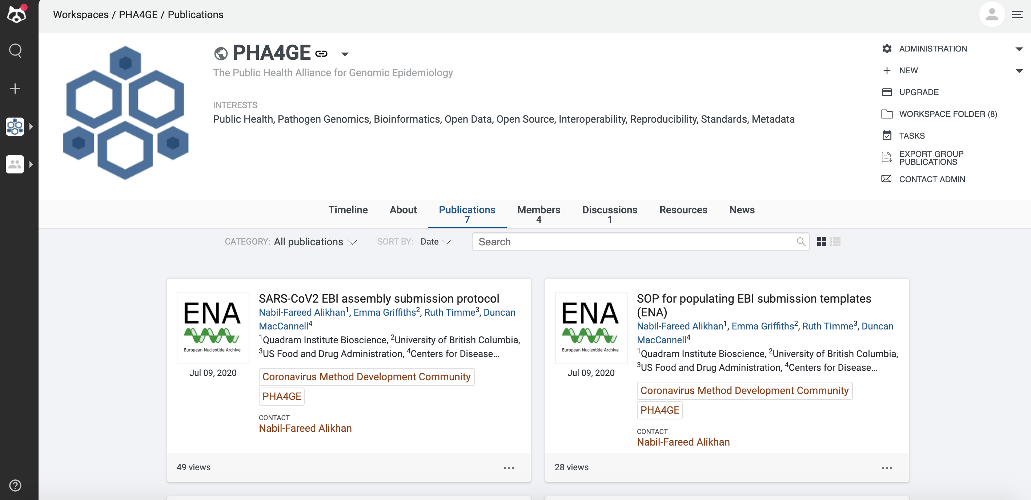

Protocols to mobilize harmonized data
7 public repository submission protocols (GISAID, NCBI, EMBL-EBI) on Protocols.io
PHA4GE-adapted submission forms
Curation SOP
instructional videos
Different repositories have different fields, but PHA4GE helps standardize what goes into those fields
https://www.protocols.io/workspaces/pha4ge

Slide 37
Other kinds of data useful for
genomic epidemiology:
Best curation practices for associating genomic data with assays, phenotypes, epidemiological data etc

Slide 38
Preparing FAIR data to maximize reuse and reproducibility
FAIR Guiding Principles (Nature, 2015)
Findable - other users can discover your data (humans AND computers)
Accessible - should be easy to retrieve
Interoperable - computer systems or software should be able to exchange and make use of information
Reusable - digital information can have many uses, should be stored in a way that enables reuse (e.g. sufficient context, provenance)
How do we make data FAIR?
Everyone: Use ontologies and data standards (datasets and systems more interoperable)
Standards developers: Make standards/ontologies available in registries/centralized resources (OBO Foundry)
Data providers: Share data in databases and repositories
Provide information on provenance, data limitations
Repositories: Make data searchable with standardized filters/tags

Slide 39


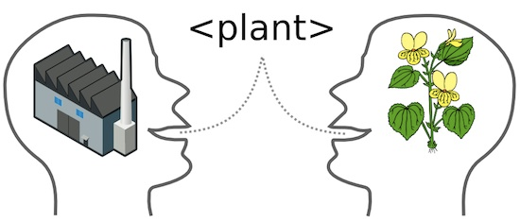
How you build an ontology (architecture) affects how you can use it.
Open Biomedical Ontologies e.g. Gene Ontology (GO)
http://www.obofoundry.org/
integrate information across sectors
Interoperability depends on:
common architecture
Basic Formal Ontology: how to group things into classes e.g. things, processes, qualities
Relation Ontology: prescribed relations e.g. is_a, adheres_in, part_of, has_role
different ontologies, reuse of terms
oversight (centralized)
open source
ID:meaning

Slide 40
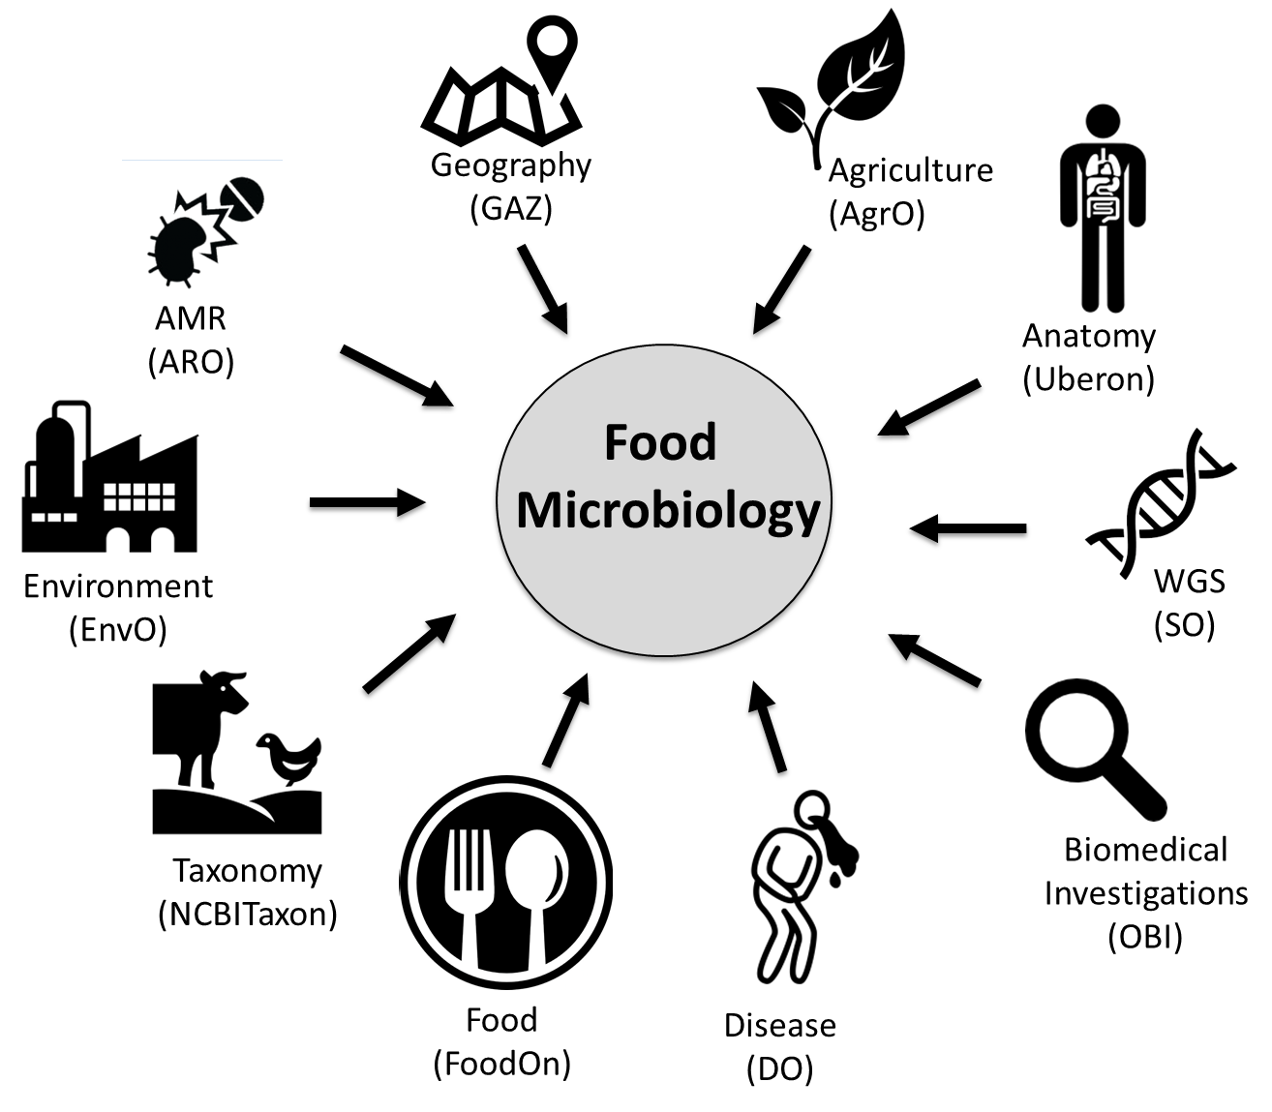
Data
OBO Foundry library (>200 ontologies)

Slide 41
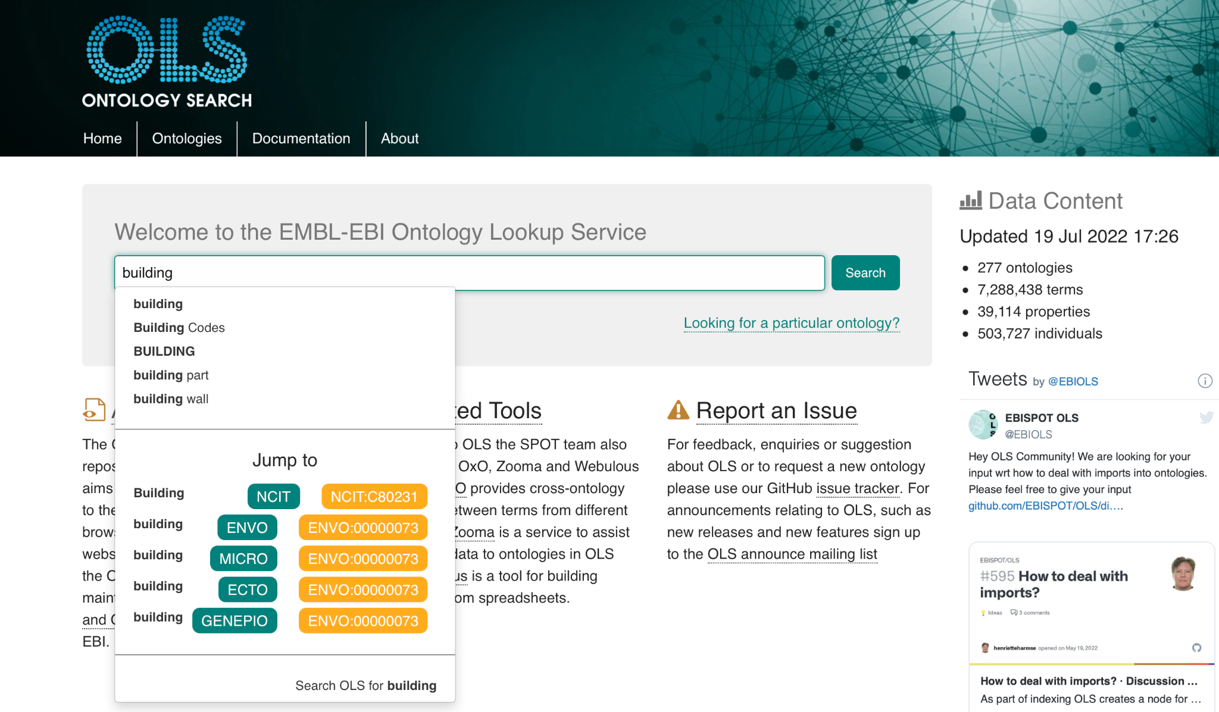
How to find ontology terms
We will use this later in the lab!
Ontology Lookup Service
Service to make ontology accessible for human (data curators) and machines (through workflows).
Many routes to the same term
EMBL-EBI OLS
A repository for all Open Biomedical (OBO) Ontologies
OLS hosts over 250 ontologies in a single place.
Over 7 million terms.
Website: https://www.ebi.ac.uk/ols
41

Slide 42
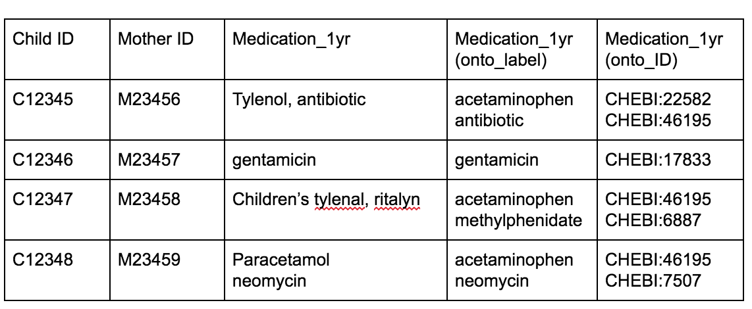

Standardization using ontology terms: medical terms (drugs)
*table contains
mock data
Chemical Entities of Biological Interest (ChEBI) ontology
Active ingredients standardized
Identify trends more easily
Use “universal language”

Slide 43
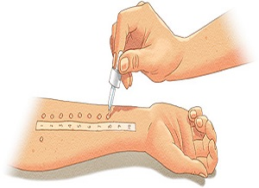
Comparing variables with implicit interpretation criteria
Experimental variables:
implicit assumptions
methods and interpretation criteria
e.g. “positive skin prick test result”
Different thresholds
2mm (Cohort A) vs 5mm (Cohort B)
= different interpretations, different results

Slide 44
Ontologies can resolve different usage/meaning of the same terms
differentiate variables → make methods and interpretation criteria more explicit
AllergyOnto:1234*
positive allergy skin prick test result (2mm)
AllergyOnto:5678*
positive allergy skin prick test result (5mm)
*these terms do not yet exist, for demonstration purposes only

Slide 45
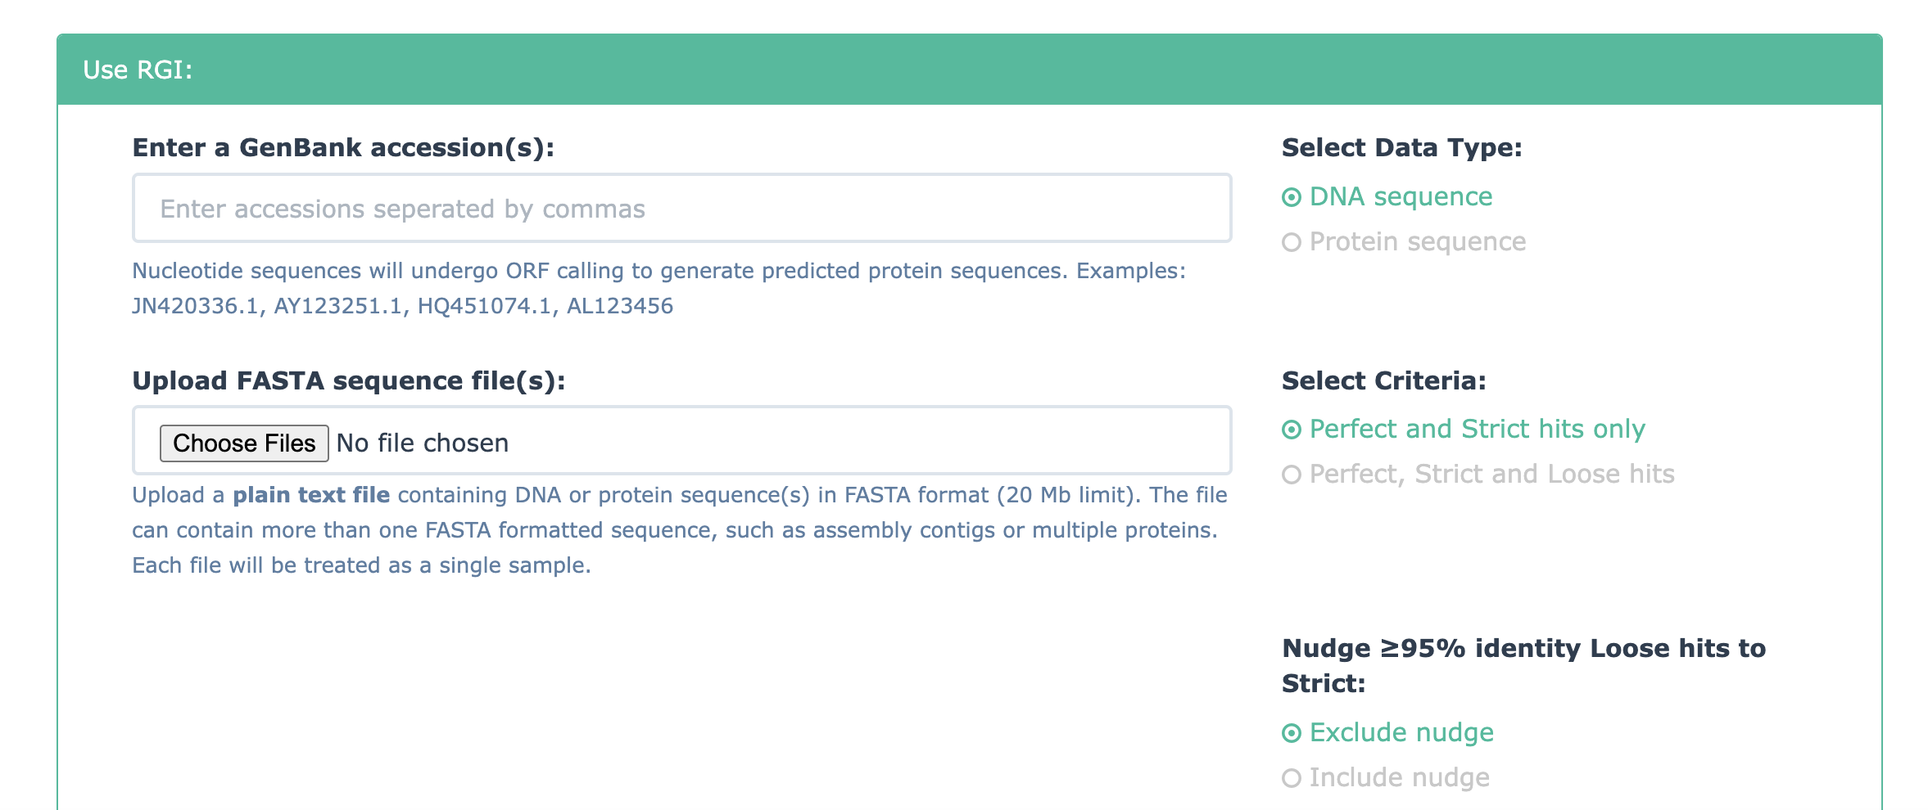
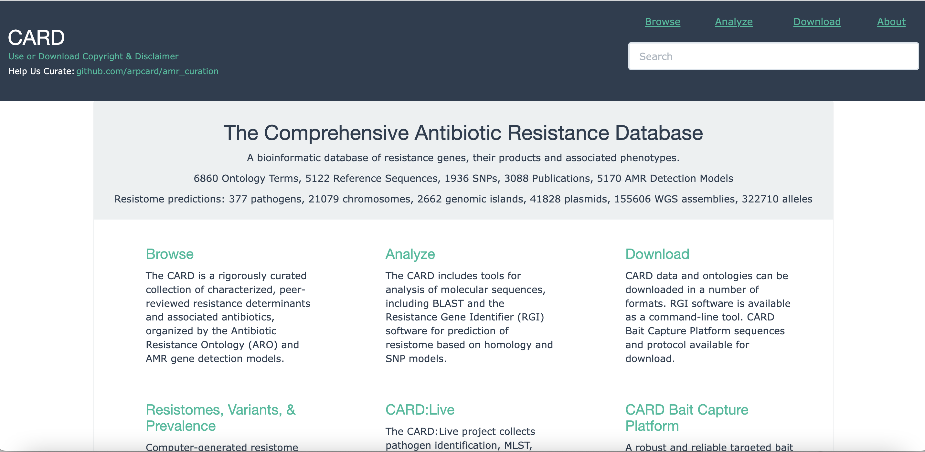
Comprehensive Antimicrobial Resistance Database (CARD)
associates genomic data with resistance genes, mechanisms of action, drug classes and more
EVIDENCE based
curators identify data and evidence
create data model (structured using ARO)
need system to ensure facts are correct!
Underpins the Resistance Gene Identifier (RGI)
Tool for analysis, identifying genomic resistance markers
https://card.mcmaster.ca/
https://card.mcmaster.ca/analyze/rgi

Slide 46
Data curation best practices
High quality content
+
Standardized structure
+
Transparent methods
+
FAIR principles
=
Open, interoperable,
useful knowledge base
(can build tools to turn facts into
actionable knowledge)
Criteria
scope
rules/cut-offs
examples
Trusted sources & evidence
Consensus
automation preferable to personal interpretation
consistency
Documentation
Versioning

Slide 47
Summary
Ontology-based data specifications increase interoperability of datasets and systems
Data management tools (e.g. DataHarmonizer) help operationalize data standards
Data sharing is important for situational awareness, decision-making, innovation
Data stewardship is important → considerations important for data sharing (privacy, security, trust)
Open and access-controlled public repositories have different advantages (GISAID, INSDC) → different submission formats
Data standardization tools and best practices help build knowledge bases useful for research

Slide 48
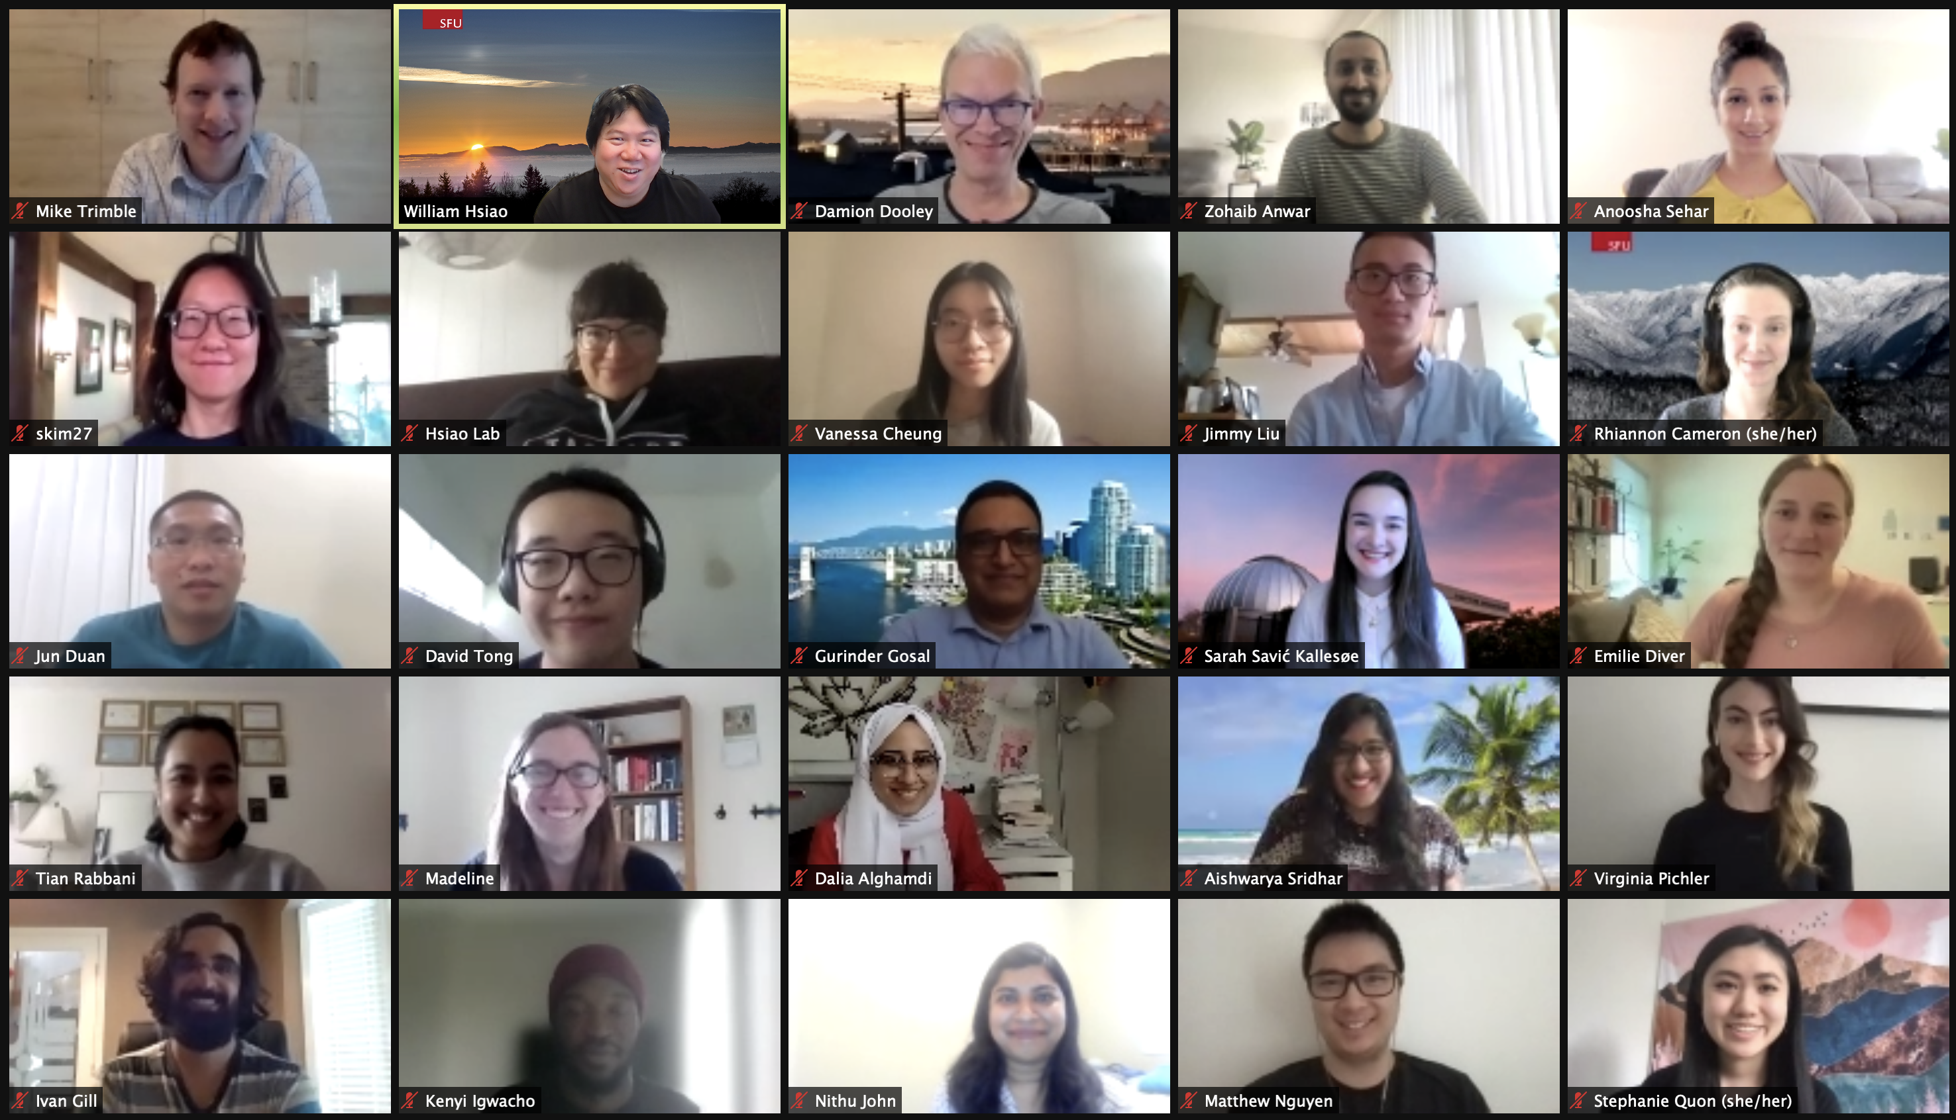
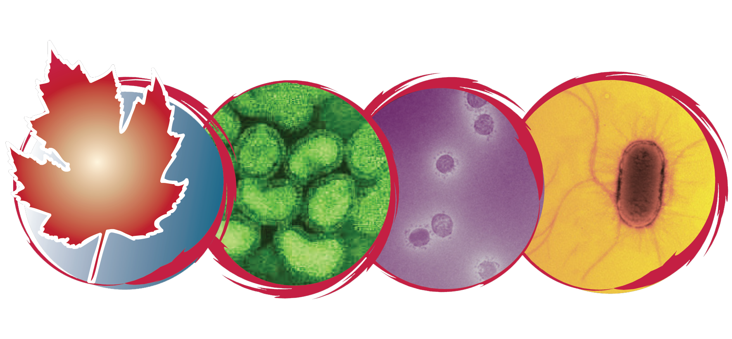






Thank you!
Centre for Infectious Disease Genomics and One Health - CIDGOH
https://cidgoh.ca/
https://github.com/cidgoh/
ega12@sfu.ca
@griffiemma

Slide 49





We are on a Coffee Break & Networking Session
Workshop Sponsors:

